Slide 1

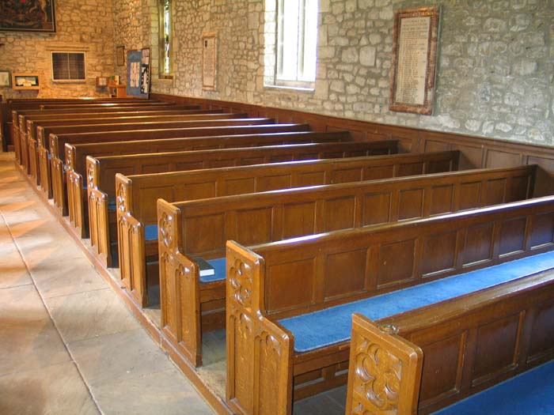





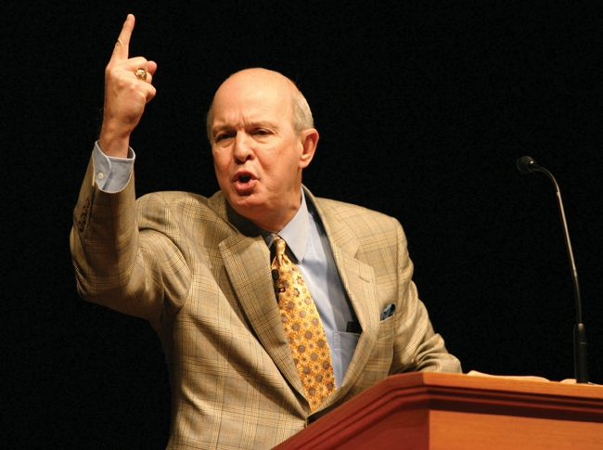
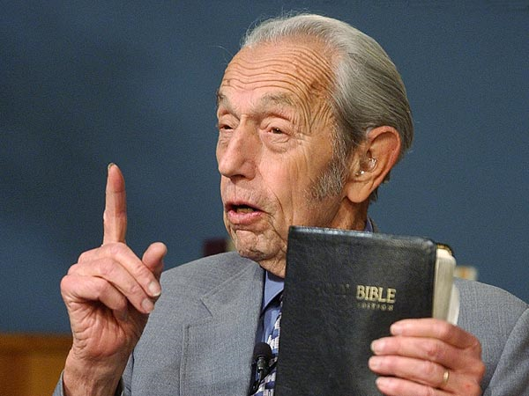



www.lettersfromGod.com
Home
Sermons
Submit
Find
Mission
Video on “The Second Coming”
By Pastor Smith
Greenbelt SDA Church 9/12/15

